Slide 1



Slide 2













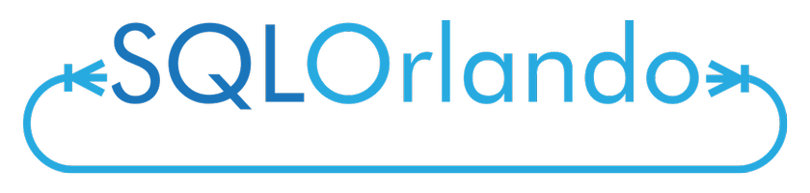


Slide 3
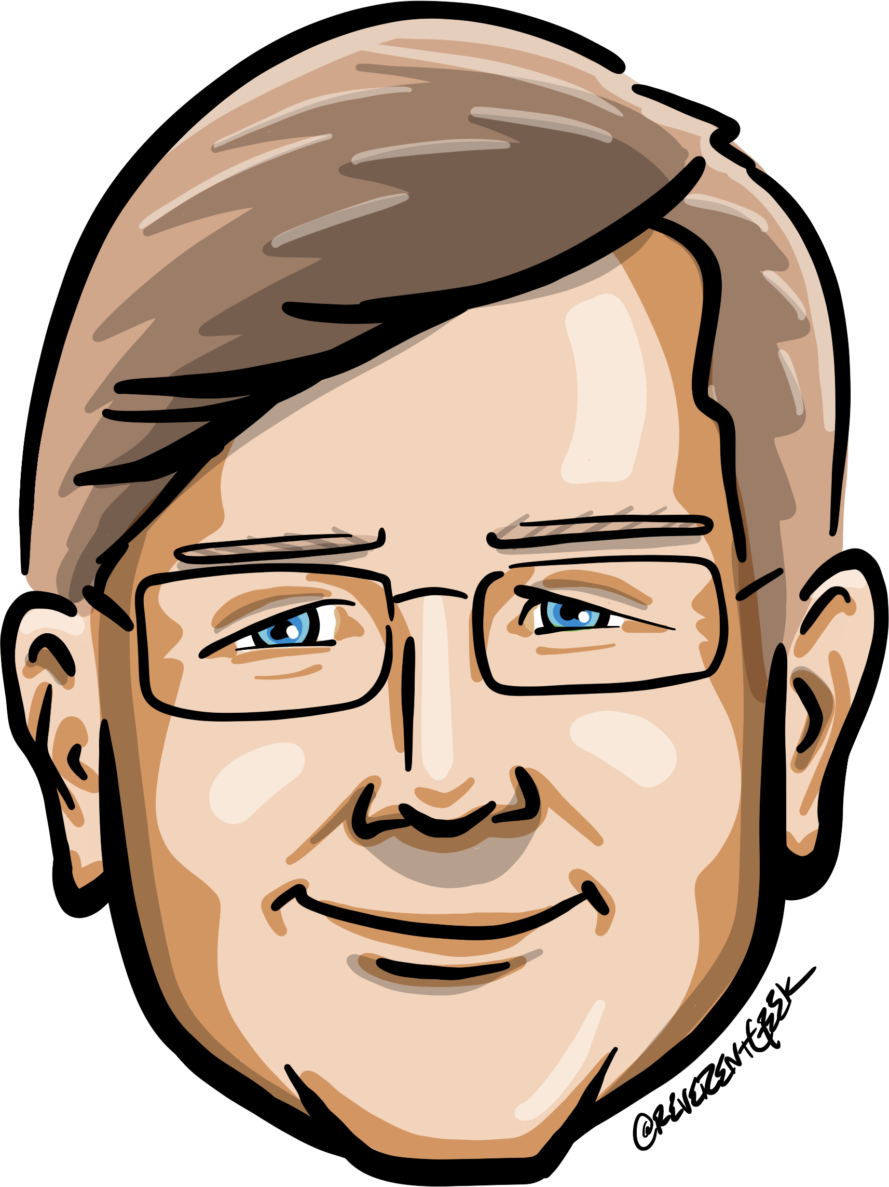







Who is Chad Green
chadgreen@chadgreen.com
TaleLearnCode
ChadGreen.com
ChadGreen & TaleLearnCode
ChadwickEGreen

Slide 4
Agenda
What is Technical Debt
Pros and Cons of Technical Debt
What Causes Technical Debt
Types of Technical Debt
Technical Debt Identification
Tracking Technical Debt

Slide 5
What is Technical Debt?
Technical Debt Is Not Free

Slide 6

What is Technical Debt?
A story as old as time
Notes:
Once upon a time, there was a software development team that was working on a project for a big client. The project was complex, and the deadline was tight, so the team decided to take shortcuts and make quick fixes instead of following best practices.
At first, everything seemed to be going well. The project was delivered on time and the client was happy with the results.
However, as time went on,

Slide 7

What is Technical Debt?
A story as old as time
Notes:
the team realized that the shortcuts they had taken were causing problems.
The code was difficult to read and maintain, which made it time-consuming and expensive to fix bugs. The team also realized that they had neglected to properly document the code,

Slide 8

What is Technical Debt?
A story as old as time
Notes:
which made it difficult for new developers to understand how the system worked.
Furthermore, the team had not done enough testing, which resulted in a high number of bugs. And the architecture of the system was overly complex, which made it difficult to make changes without breaking other parts of the system.

Slide 9

What is Technical Debt?
A story as old as time
Notes:
As a result of these problems, the team found themselves spending more and more time fixing bugs and maintaining the system instead of working on new features.

Slide 10

What is Technical Debt?
A story as old as time
Notes:
The client was also becoming frustrated because the system was not performing as well as they had hoped.
The team eventually realized that the shortcuts they had taken were the cause of their problems. They had accumulated a significant amount of technical debt, which as making it difficult for them to deliver the quality software that their client required.

Slide 11

What is Technical Debt?
A story as old as time
Notes:
The stress of the situation was waking a toll on the team. Developers were working long hours and feeling overwhelmed, which was affecting their morale and their health.

Slide 12

What is Technical Debt?
A story as old as time
Notes:
Some even started to look for new jobs because they did not want to work on a project that was so difficult to maintain.
In the end, the team realized that the shortcuts they had taken were the cause of their problem. They had accumulated a significant amount of technical debt, which was making it difficult for them to deliver the quality software that their client required.

Slide 13

What is Technical Debt?
A story as old as time
Notes:
The team had to work hard to pay off their technical debt, which took a lot of time and money.

Slide 14

What is Technical Debt?
A story as old as time
Notes:
They also had to find new developers to replace those who had left, which added to their difficulties.

Slide 15

What is Technical Debt?
A story as old as time
Notes:
From then on, the team was more careful to follow best practices and avoid technical debt. They learned the hard way about the importance of taking the time to do things right, even if it means delivering the project a little late. They also made sure to prioritize their health and well-being, so that could continue to deliver high-quality software for their clients.

Slide 16

What is Technical Debt?
First described by Ward Cunningham in 1992
Notes:
“Shipping first-time code is like going into debt. A little debt speeds development so long as it is paid back promptly with a rewrite. Objects make the cost of this transaction tolerable.

Slide 17
What is Technical Debt?
First described by Ward Cunningham in 1992
The danger occurs when the debt is not repaid
Notes:
The danger occurs when the debt is not repaid.

Slide 18
What is Technical Debt?
First described by Ward Cunningham in 1992
Every minute spent on not-quite-right code counts as interest on that debt.
Notes:
Every minute spent on not-quite-right code counts as interest on that debt.

Slide 19
What is Technical Debt?
First described by Ward Cunningham in 1992
…brought to a stand-still under the debt load of an unconsolidated implementation
Notes:
Entire engineering organizations can be brought to a stand-still under the debt load of an unconsolidated implementation, object-oriented or otherwise."

Slide 20

What is Technical Debt?
Common definition comes from Martin Fowler
Notes:
In this metaphor, doing things

Slide 21

What is Technical Debt?
Common definition comes from Martin Fowler
quick and dirty way
Notes:
the quick and dirty way sets us up with a technical debt, which is similar to a financial debt. Like a financial debt, the technical debt

Slide 22
What is Technical Debt?
Common definition comes from Martin Fowler
incurs interest payments
Notes:
incurs interest payments, which come in the form of the

Slide 23
What is Technical Debt?
Common definition comes from Martin Fowler
extra effort that we have to do in future development
Notes:
extra effort that we have to do in future development.

Slide 24

What is Technical Debt?
More academic definition
implied cost
Notes:
The implied cost of additional

Slide 25
What is Technical Debt?
More academic definition
rework
Notes:
rework caused by

Slide 26
What is Technical Debt?
More academic definition
choosing easy
Notes:
choosing an easy (limited) solution now instead of using a

Slide 27
What is Technical Debt?
More academic definition
better approach
Notes:
better approach that would take longer

Slide 28
A more reasonable definition
A state of unnecessary complexity, duplication, subpar code, or otherwise deficient code that introduces risks in the form of time, quality, security, team morale, or other forms. Typically the results of past action or inaction.
Matt Eland
killalldefects.com/2019/12/23/defining-technical-debt

Slide 29
Technical Debt is Bad

Slide 30
Technical Debt is Bad

Slide 31
Technical Debt can be Bad

Slide 32
Technical Debt can be Devastating

Slide 33
Technical Debt can be Useful

Slide 34
Technical Debt can be Beneficial

Slide 35
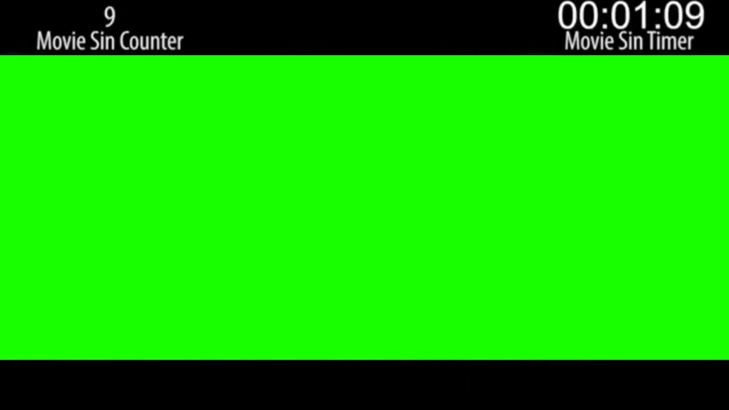
Technical Debt is not Free

Slide 36
Technical Debt Example
No User Roles
Notes:
You start writing an application. In the beginning there is no need for user roles. Everyone can do everything.

Slide 37
Technical Debt Example
No User Roles
Permission for Specific Requirement
Notes:
At some point you starting having two different permissions for a specific action, like one kind of user can see a report and the other cannot. The development team considers whether to create a full-fledged permission system, using a nice set of design patterns for it. But at this point it really looks like over-engineering. One method in the business logic and one in the presentation layer will do.

Slide 38
Technical Debt Example
No User Roles
Permission for Specific Requirement
Differentiation of Users
Notes:
Some time later another things requires the differentiation of users, and then another, and another. At this point, the developers realized that the code is starting to get messy, and the solution is to refactor the code to have a decent permission system. But this refactoring will take time than just adding another method But will simplify the code and make future permissions to be added one line of code, or even by just adding a row in the database.

Slide 39
Technical Debt Example
No User Roles
Permission for Specific Requirement
Differentiation of Users
Yet Another Permission Change
Notes:
The company has the opportunity to add five customer in a week, but really need another permission change in a couple of days.
The problem is that there really is a business need to have the current permission live in one or two days, because this will make five potential customers sign a contract this week, rather than next week, or maybe never, if they dislike the fact that the company haven’t done their only request.

Slide 40
Technical Debt Example
No User Roles
Permission for Specific Requirement
Differentiation of Users
Yet Another Permission Change

Slide 41
Another Technical Debt Example
.NET 5
Current Release
.NET 6
LTS Release
Notes:
Long Term Support (LTS) _ LTS releases are supported for three years after the initial release.
Current – Current releases are supported for six months after a subsequent Current or LTS release. Release happen every 12 months, so the support period for Current is 18 months.
.NET 5 – Original Release Date – November 10, 2020
.NET 5 – End of Support – May 10, 2022
.NET 6 – Original Release Date – November 8, 2021
.NET 6 – End of Support – November 13, 2022

Slide 42
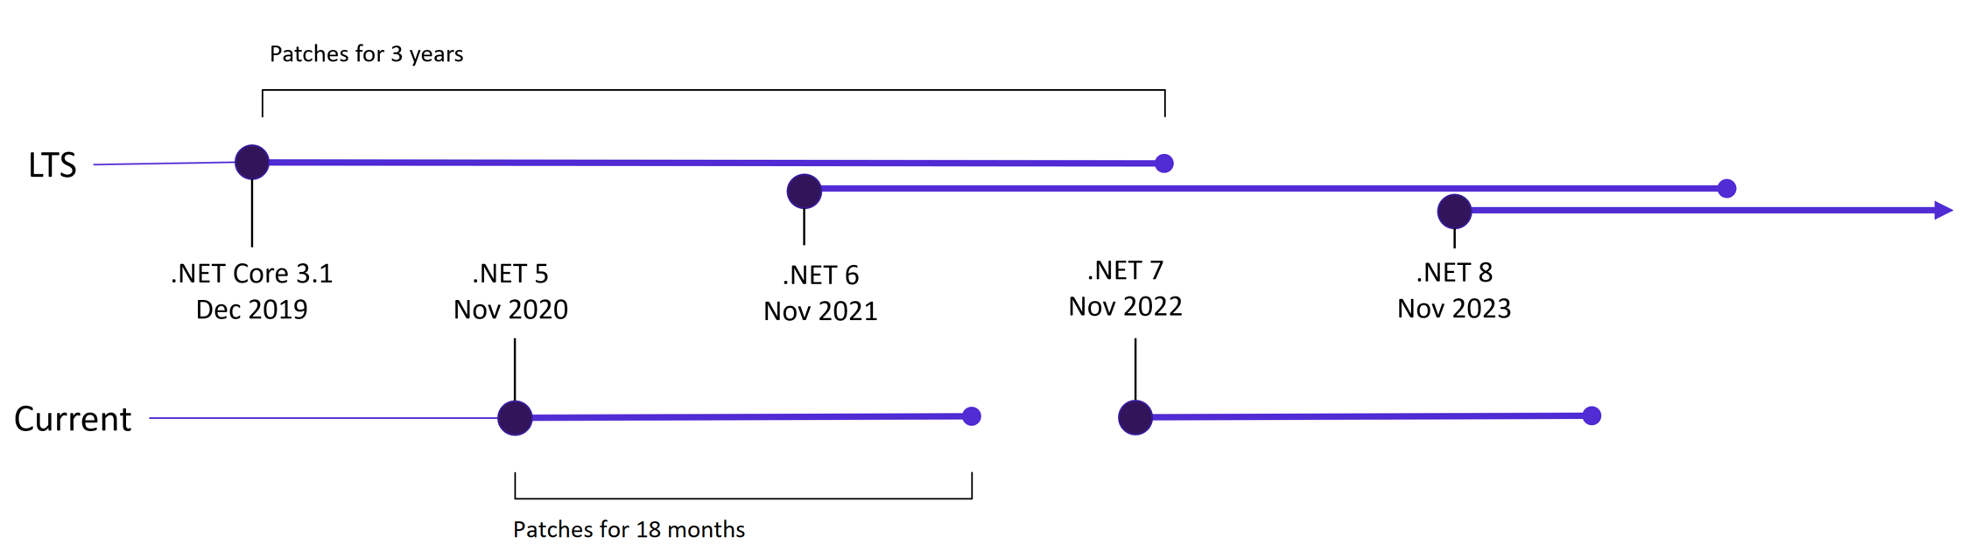
Another Technical Debt Example

Slide 43
Pros and Cons of Technical Debt
Technical Debt Is Not Free

Slide 44
Technical Debt Pros
Supplier
Customer
Faster time to market
Short term competitive advantage
New features faster
Short term capital preservation

Slide 45
Technical Debt Cons
Supplier
Customer
Degradation of quality
Limits ability to innovate
Longer development cycles
Less responsive to market changes
Customer churn
Developer churn
Higher upgrade costs
System compatibility issues
Poor end user experience
Less responsive to market changes
Poor IT morale

Slide 46
What causes technical debt?
Technical Debt is Not Free

Slide 47

Insufficient up-front definition
What causes technical debt?
Notes:
Insufficient up-front definition, where requirements are still being defined during development, development starts before any design takes place. This is done to save time but often has to be reworked later.

Slide 48

Business Pressures
What causes technical debt?
Notes:
Business pressures, where the business considers getting something released sooner before all of the necessary changes are complete, builds up technical debt comprising those uncompleted changes.

Slide 49

Lack of process or understanding
What causes technical debt?
Notes:
Lack of process or understanding, where businesses are blind to the concept of technical debt and make decisions without considering the implications.

Slide 50

Tightly-coupled components
What causes technical debt?
Notes:
Tightly-coupled components, where functions are not modular, the software is not flexible enough to adapt to changes in business needs.

Slide 51
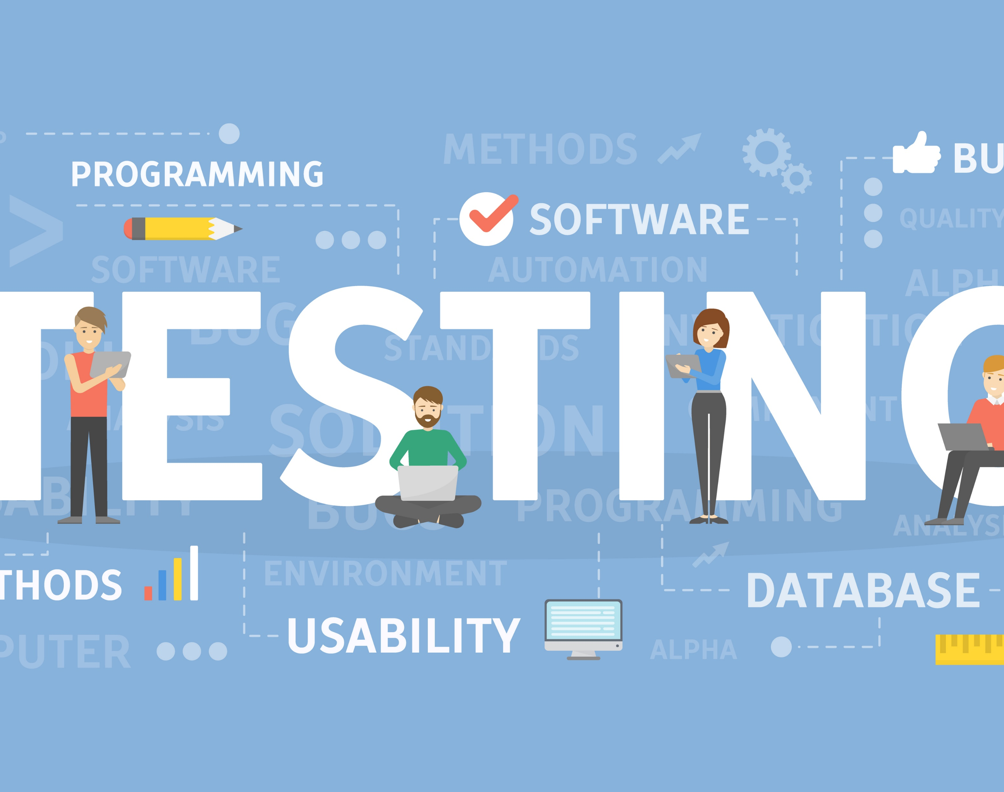
Lack of a test suite
What causes technical debt?
Notes:
Lack of a test suite, which encourages quick and risky band-aids to fix bugs.

Slide 52
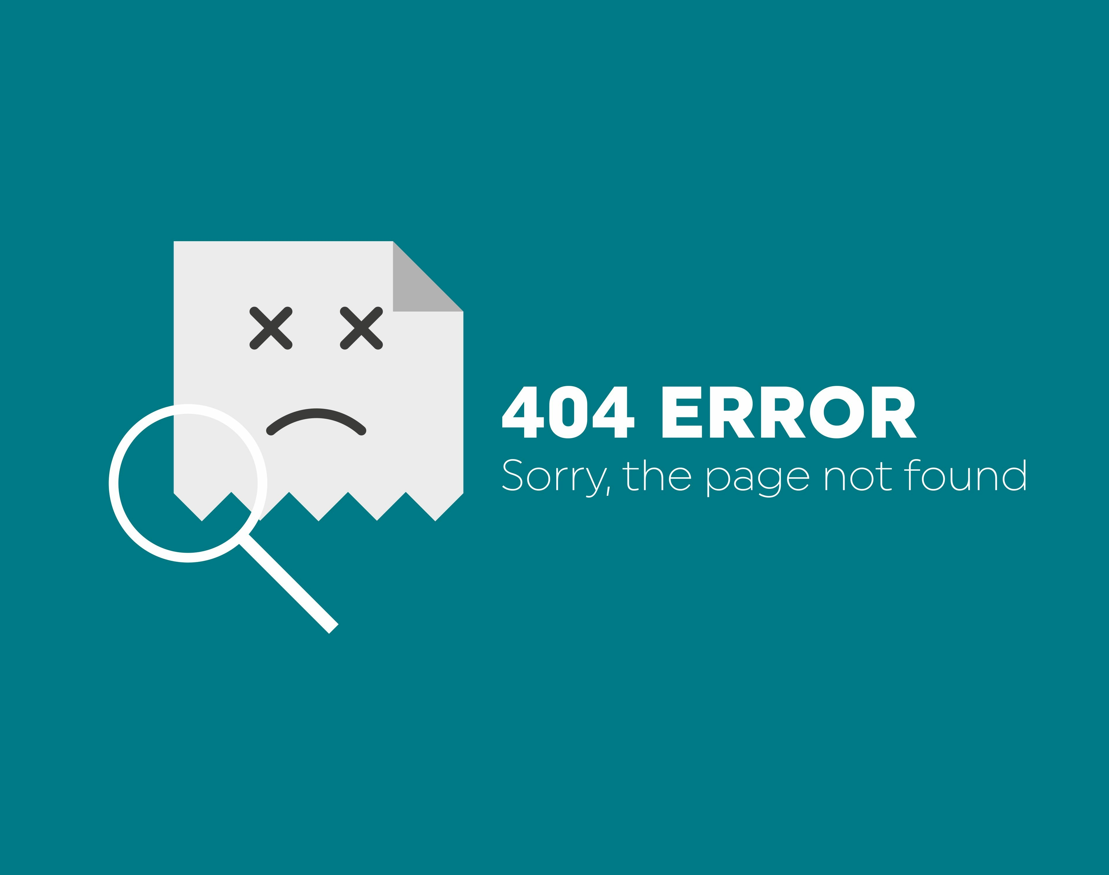
Lack of documentation
What causes technical debt?
Notes:
Lack of documentation, where code is created without necessary supporting documentation. The work to create any supporting documentation represents a debt that must be paid.

Slide 53

Lack of collaboration
What causes technical debt?
Notes:
Lack of collaboration, where knowledge isn't shared around the organization and business efficiency suffers, or junior developers are not properly mentored.

Slide 54

Parallel development
What causes technical debt?
Notes:
Parallel development on two or more branches accrues technical debt because of the work required to merge the changes into a single source base. The more changes that are done in isolation, the more debt is piled up.

Slide 55

Delayed refactoring
What causes technical debt?
Notes:
Delayed refactoring – As the requirements for a project evolve, it may become clear that parts of the code have become inefficient or difficult to edit and must be refactored in order to support future requirements. The longer that refactoring is delayed, and the more code is added, the bigger the debt.

Slide 56

Lack of alignment to standards
What causes technical debt?
Notes:
Lack of alignment to standards, where industry standard features, frameworks, technologies are ignored. Eventually, integration with standards will come, doing sooner will cost less (similar to 'delayed refactoring').

Slide 57

Lack of knowledge
What causes technical debt?
Notes:
Lack of knowledge, when the developer simply doesn't know how to write elegant code.

Slide 58

Lack of ownership
What causes technical debt?
Notes:
Lack of ownership, when outsourced software efforts result in in-house engineering being required to refactor or rewrite outsourced code.

Slide 59

Poor technical leadership
What causes technical debt?
Notes:
Poor technological leadership where poorly thought out commands handed down the chain of command increases the technical debt rather than reduce it.

Slide 60

Last minute specification changes
What causes technical debt?
Notes:
Last minute specification changes; these have potential to percolate throughout a project but no time or budget to see them through with documentation and checks.

Slide 61
What causes technical debt?
Insufficient up-front definition
Business pressures
Lack of process of understanding
Tightly-coupled components
Lack of a test suite
Lack of documentation
Lack of collaboration
Parallel development
Delayed refactoring
Lack of alignment to standards
Lack of knowledge
Lack of ownership
Poor technical leadership
Last minute specification

Slide 62
Types of Technical Debt
Technical Debt Is Not Free

Slide 63
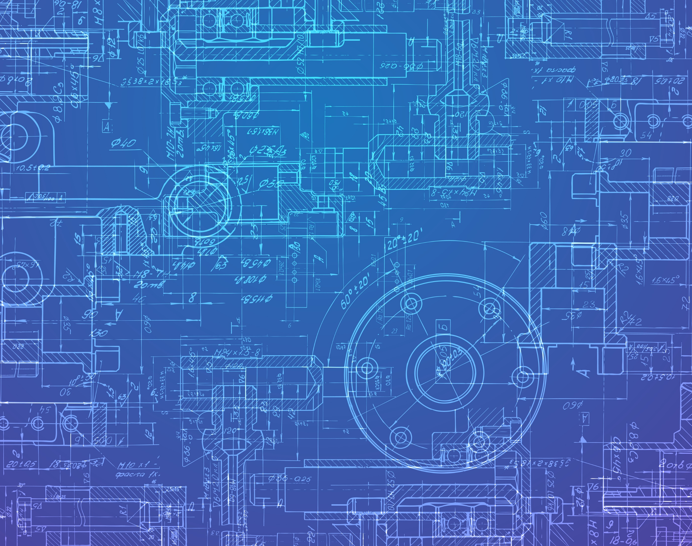
Architecture
Types of Technical Debt
Notes:
Architecture debt : Refers to problems encountered in architecture – for example, violation of modularity – that can affect architectural requirements (including performance and robustness, among others).

Slide 64

Build
Types of Technical Debt
Notes:
Build debt : Refers to issues that make builds more difficult or resource consuming than necessary.

Slide 65

Code
Types of Technical Debt
Notes:
Code debt : Refers to problems found in the source code that make it more difficult to be maintained.

Slide 66

Defect
Types of Technical Debt
Notes:
Defect debt : Refers to known defects, usually identified by testing activities or by the user, that the change control board agrees should be fixed, but have been deferred due to competing priorities and limited resources.

Slide 67

Design
Types of Technical Debt
Notes:
Design debt : Refers to debt that can be discovered by analyzing the source code and identifying the use of practices that violate the principles of good object-oriented design (for example, very large or tightly coupled classes).

Slide 68

Documentation
Types of Technical Debt
Notes:
Documentation debt : Refers to problems found in software project documentation, including missing, inadequate, or incomplete documentation of any type.

Slide 69

Infrastructure
Types of Technical Debt
Notes:
Infrastructure debt : Refers to infrastructure issues that can delay or hinder some development activities.

Slide 70

People
Types of Technical Debt
Notes:
People debt : Refers to people issues – for example, expertise concentrated in too few people as a result of delayed training – that can delay or hinder some development activities.
The bus factor is a measurement of the risk resulting from information and capabilities not being shared among team members, derived from the phrase "in case they get hit by a bus".

Slide 71
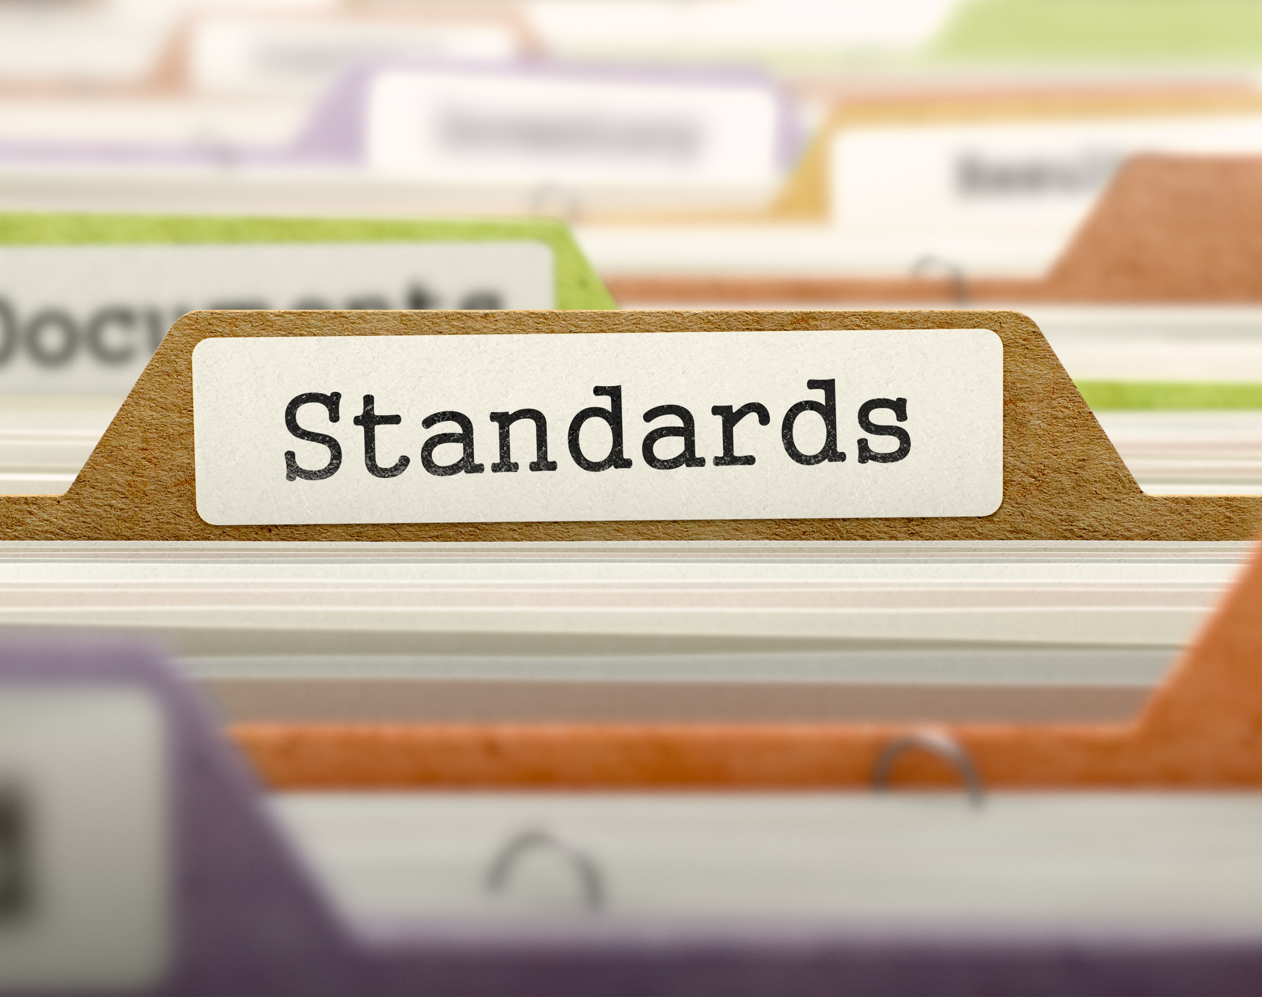
Process
Types of Technical Debt
Notes:
Process debt : Refers to inefficient processes, for example, processes for which the initial use case is no longer appropriate.

Slide 72
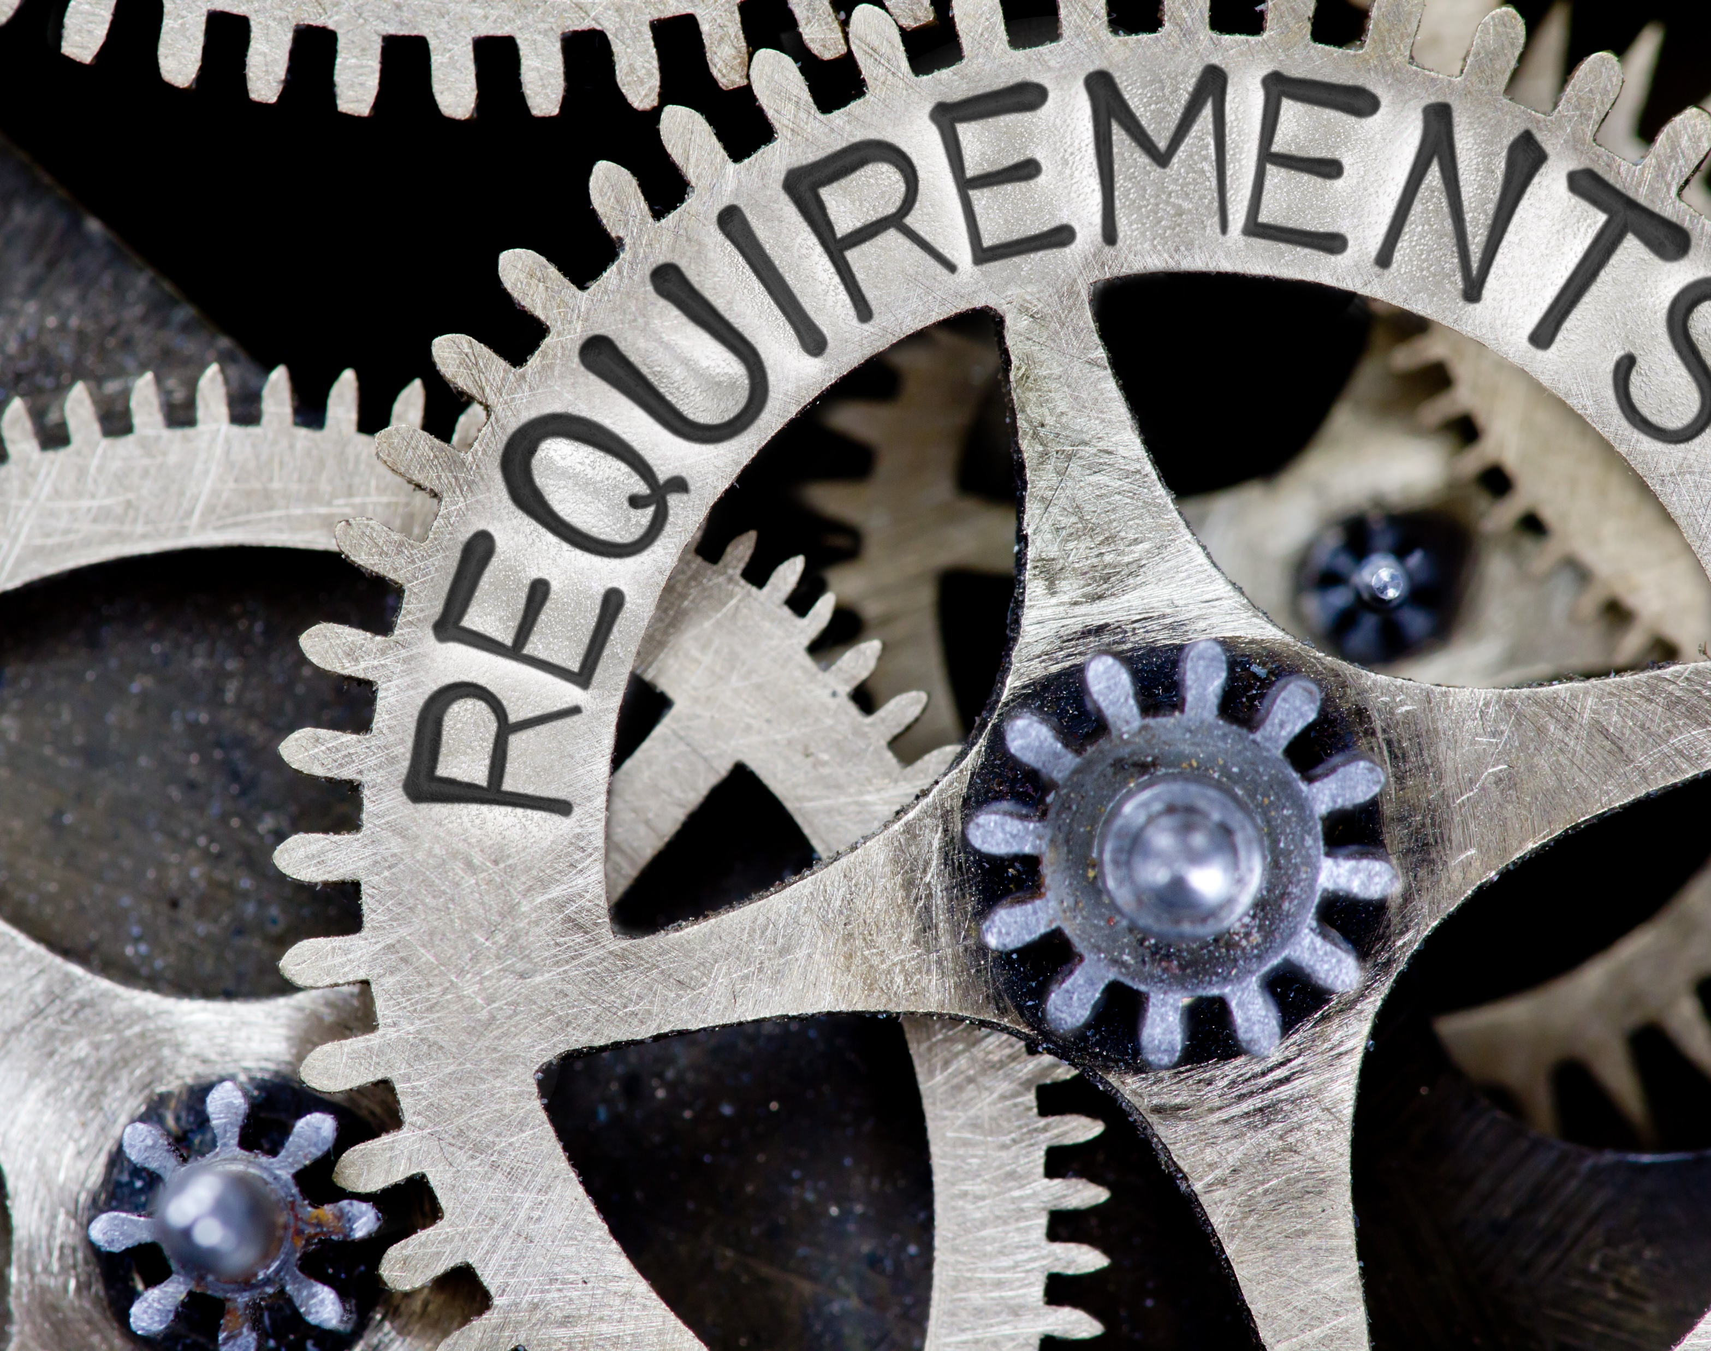
Requirement
Types of Technical Debt
Notes:
Requirement debt : Refers to tradeoffs made with respect to the specific requirements the development team has to implement or how to implement them. Examples include requirements that are only partially implemented, or requirements that are implemented but not for all cases.

Slide 73

Service
Types of Technical Debt
Notes:
Service debt : Refers to debt incurred by the need for web service substitution, which can be driven by business or technical objectives. The technical debt can span several dimensions related to selection, composition, and operation of the service.

Slide 74
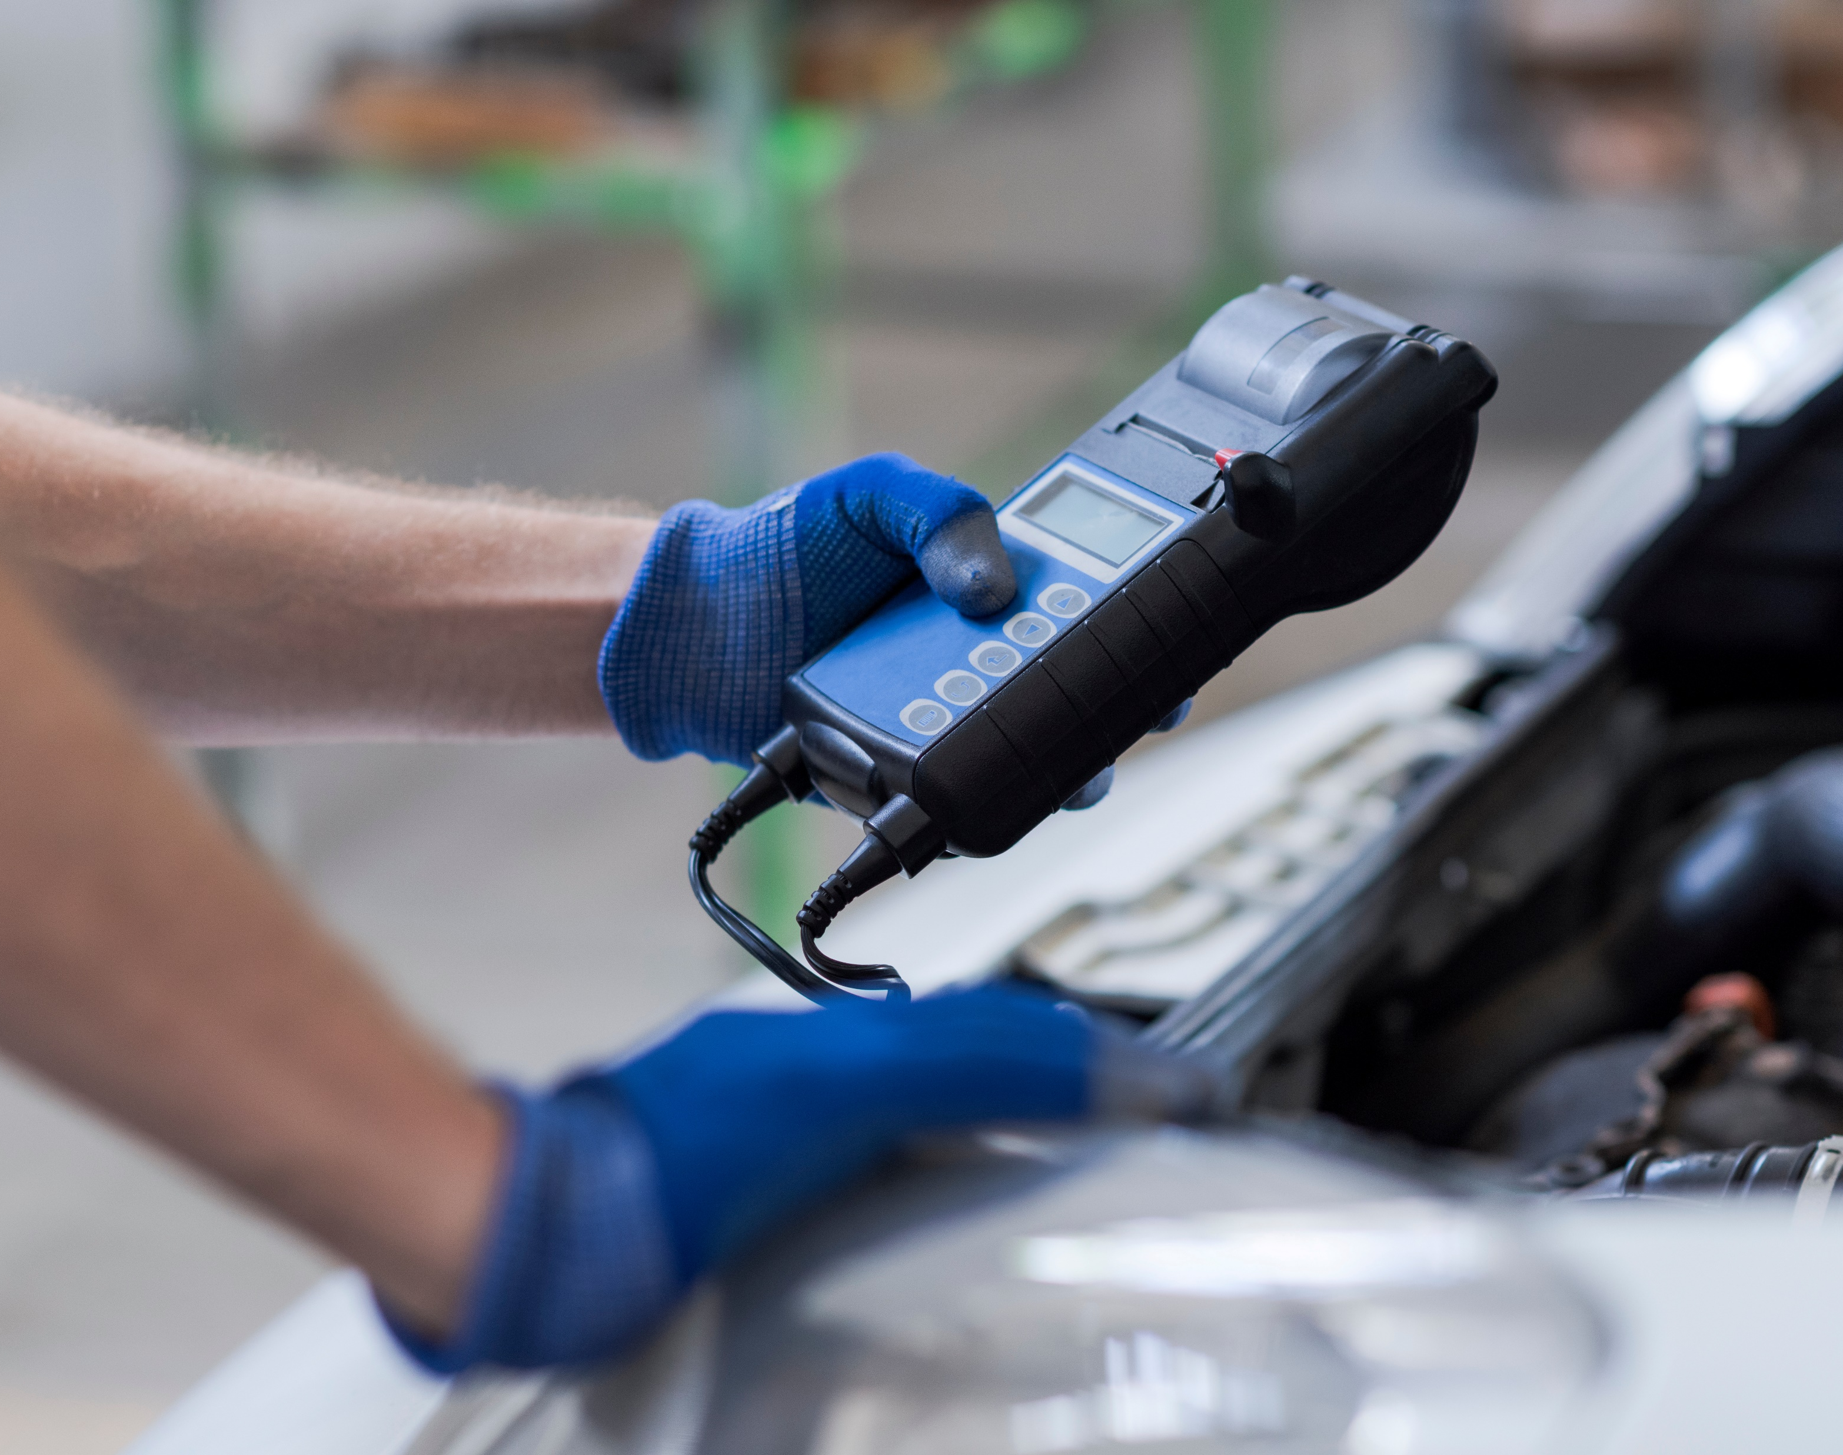
Test Automation
Types of Technical Debt
Notes:
Test automation debt : Refers to the work needed to automate tests of previously developed functionality to support continuous integration and faster development cycles.

Slide 75

Test
Types of Technical Debt
Notes:
Test debt : Refers to issues that can affect the quality of testing activities. Examples of this type of debt are planned tests that were not run, poor code coverage, or other known deficiencies in the test suite.

Slide 76
Types of Technical Debt
Architecture
Build
Code
Defect
Design
Documentation
Infrastructure
Process
Requirement
Service
Test Automation
Test

Slide 77
Technical Debt Identification
Technical Debt Is Not Free

Slide 78
Technical Debt Identification
Code Quality
Clarity
Notes:
Clarity – Easy to read and legible to anyone who has not written the code themselves

Slide 79
Technical Debt Identification
Code Quality
Maintainability
Notes:
Maintainability – Easy to understand the context and not being over-complicated makes it easier to make changes in the code when required

Slide 80
Technical Debt Identification
Code Quality
Documentation
Notes:
Documentation – While well-written code explains itself, it is always recommended to add comments to explain the role it plays and its functions

Slide 81
Technical Debt Identification
Code Quality
Refactoring
Notes:
Documentation – While well-written code explains itself, it is always recommended to add comments to explain the role it plays and its functions

Slide 82
Technical Debt Identification
Code Quality
Well-Tested
Notes:
Well-tested – The lest amount of bugs a software has, the higher its quality is. Rigorous testing helps filter out such discrepancies.

Slide 83
Technical Debt Identification
Code Quality
Efficiency
Notes:
Efficiency – High-quality code uses the resources available, so it optimally performs the desired action

Slide 84
Technical Debt Identification
Code Quality
Technical Deficiencies
Have other teams built similar solutions?
Notes:
Have other teams built similar solutions for similar needs? If so, can they be condensed into one solution or into less complex solutions with shared maintenance?

Slide 85
Technical Debt Identification
Code Quality
Technical Deficiencies
Are there inconsistent user experiences?
Notes:
Are there inconsistent user experiences for the same processes?

Slide 86
Technical Debt Identification
Code Quality
Technical Deficiencies
Are solutions using the same reusable frameworks?
Notes:
Are solutions following the same reusable frameworks?

Slide 87
Technical Debt Identification
Code Quality
Technical Deficiencies
Are best practices being followed?
Notes:
Are solutions built following best practices?

Slide 88
Technical Debt Identification
Code Quality
Technical Deficiencies
Are deployments taking too long?
Notes:
Are deployments or package validations taking too long?

Slide 89
Technical Debt Identification
Code Quality
Technical Deficiencies
Are limits being exceeded, or are users seeing errors?
Notes:
Are limits being exceeded, or are users seeing errors for SQL, DML record locks, API calls, or CPU time limits?

Slide 90
Technical Debt Identification
Code Quality
Technical Deficiencies
Business Misalignment

Slide 91
Opportunities to Identify Technical Debt
Technical Debt Is Not Free

Slide 92

Coding
Opportunities to Identify Technical Debt

Slide 93

Manifesto for Software Craftsmanship
Not only working software,
but also well-crafted software
Not only responding to change
but also steadily adding value
Not only individuals and interactions
but also a community of professionals
Not only customer collaboration
but also productive partnerships
Notes:
As aspiring Software Craftsmen we are raising the bar of professional software development by practicing it and helping others learn the craft. Through this work we have come to value.

Slide 94

Code Reviews
Opportunities to Identify Technical Debt

Slide 95
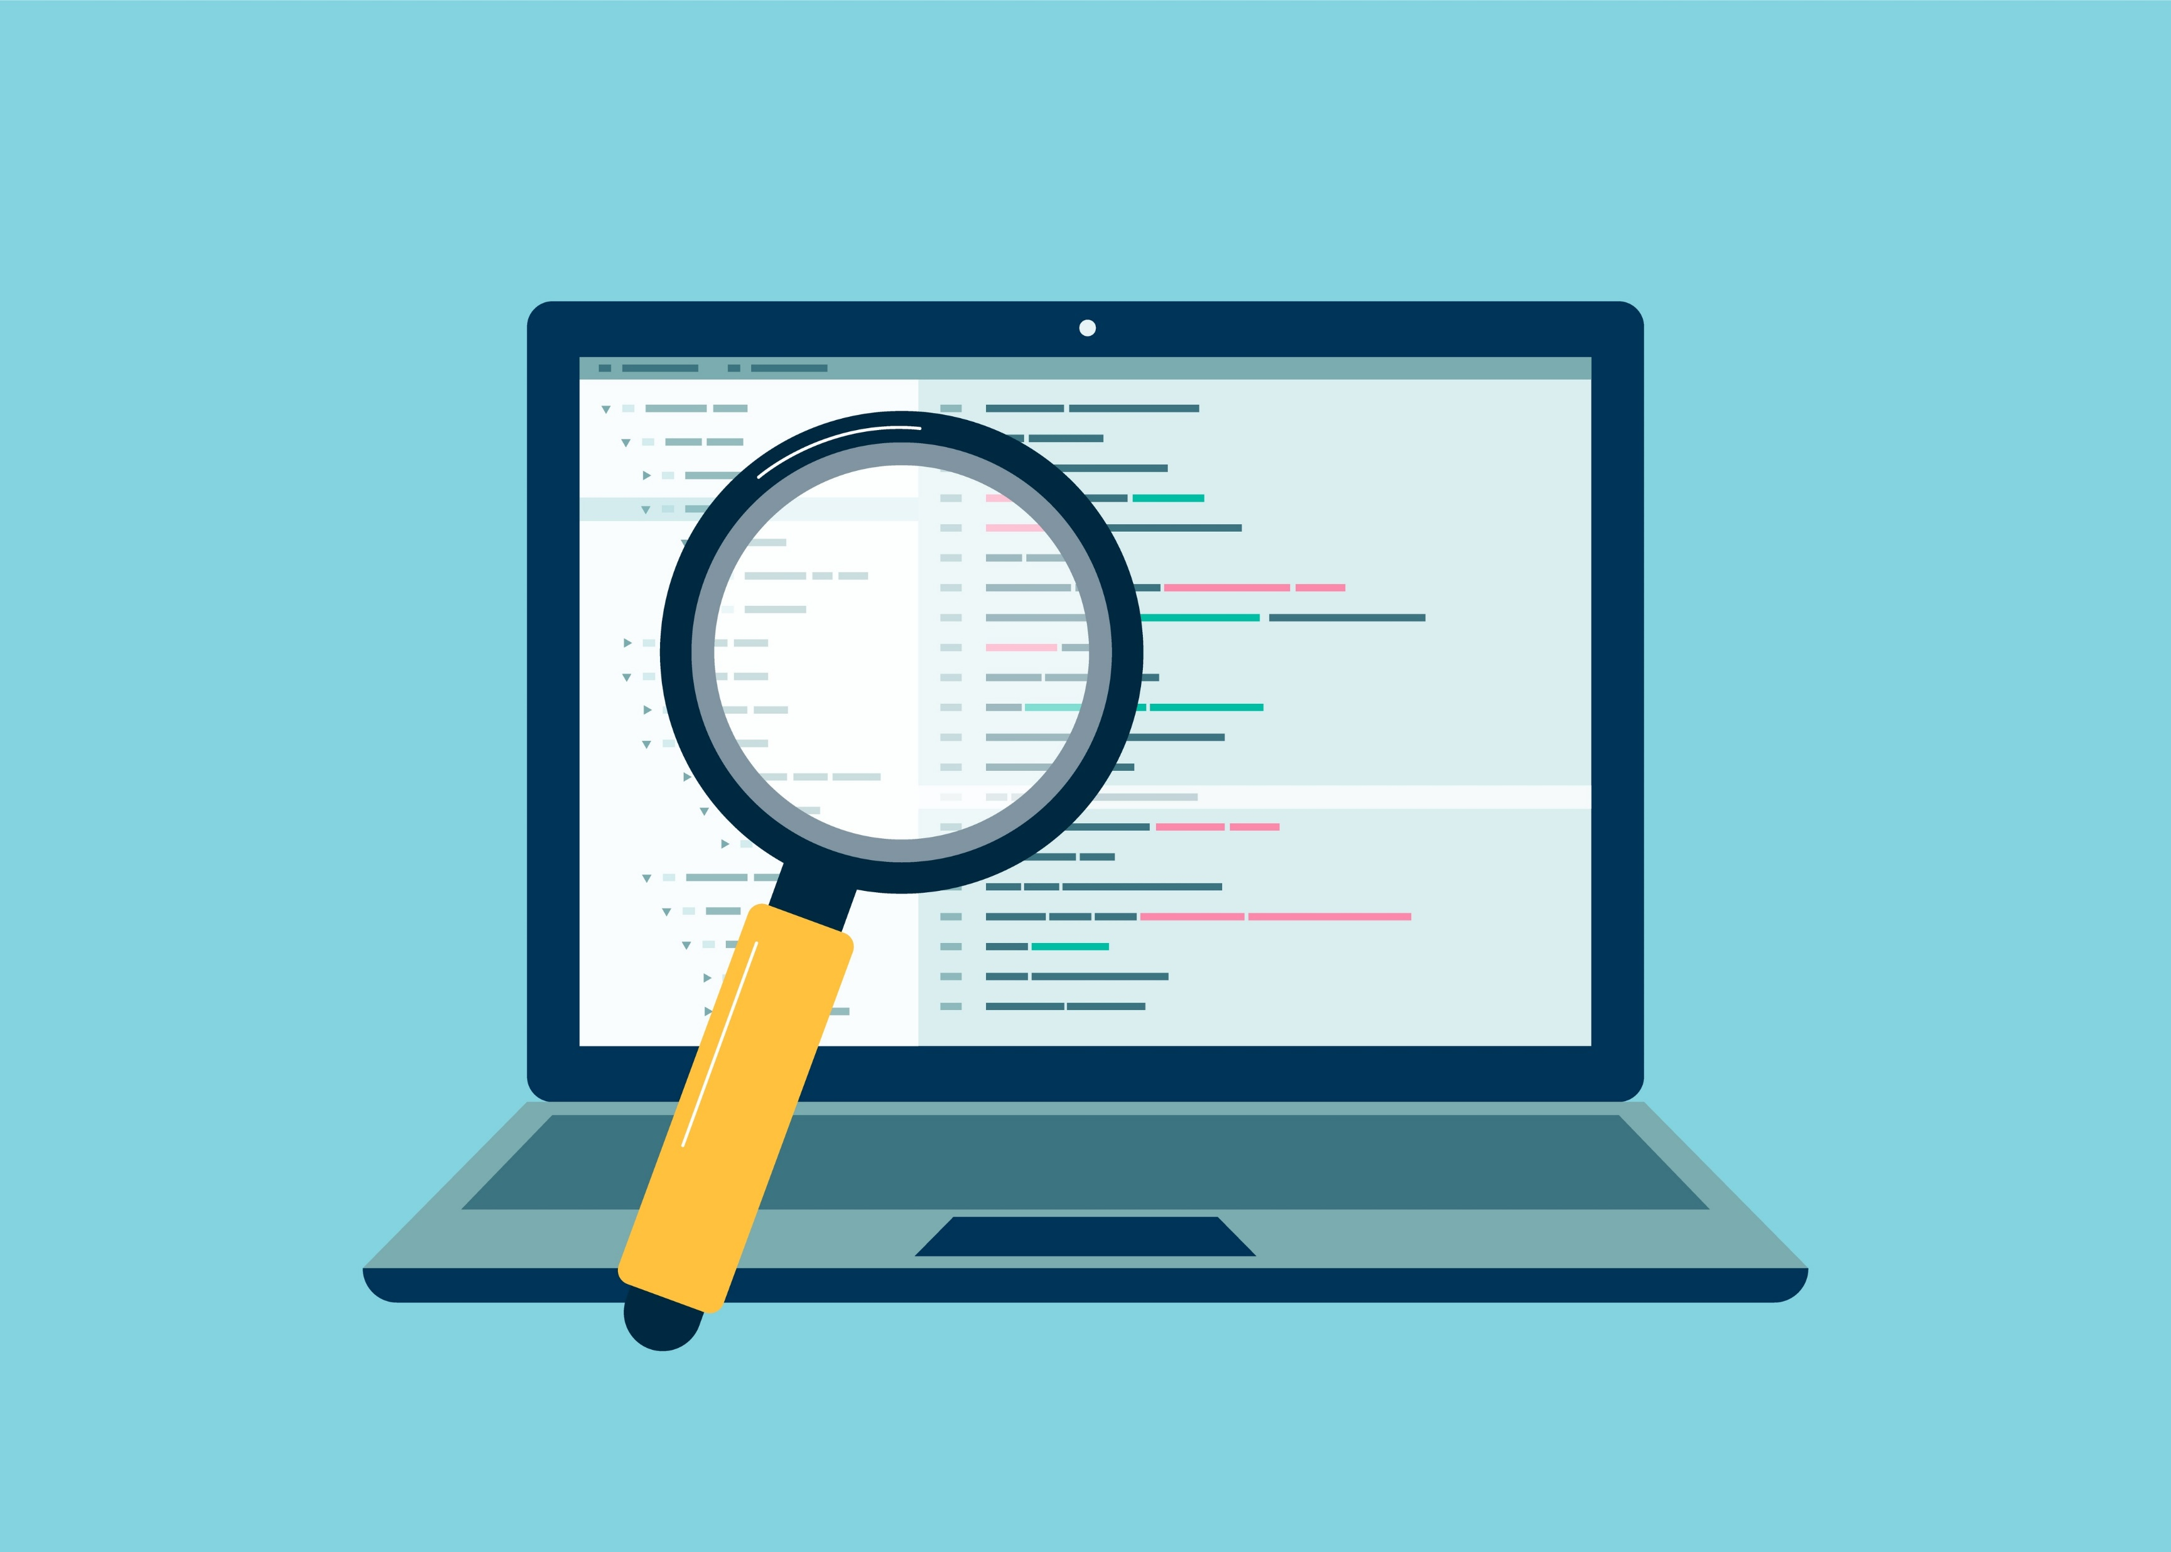
Code Analysis Tools
Opportunities to Identify Technical Debt

Slide 96
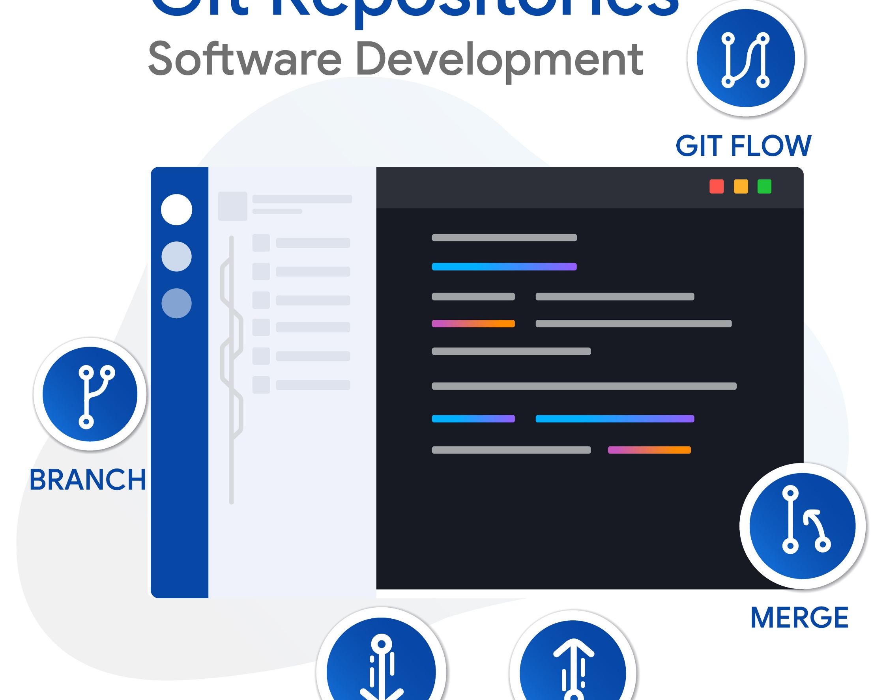
Pull Requests
Opportunities to Identify Technical Debt

Slide 97

Stand Up
Opportunities to Identify Technical Debt

Slide 98

Sprint Review
Opportunities to Identify Technical Debt

Slide 99

Often hidden in plain sight
Opportunities to Identify Technical Debt

Slide 100
Recoding Technical Debt
Technical Debt Is Not Free

Slide 101

Recording Technical Debt
User Story
Product Backlog Item
Requirement
Issue
Notes:
Agile – User Story
Scrum – Product Backlog item
CMMI – Requirement
Basic - Issue

Slide 102

Recording Technical Debt
User Story
Product Backlog Item
Requirement
Issue
Bug

Slide 103
Key Information to Record
Problem Statement
We need to refactor our SSO.
Notes:
Add business context when communicating technical debt.
Communicating the need for technical debt projects to business leaders is crucial, but often a challenge for technical leaders.

Slide 104
Key Information to Record
Problem Statement
In 22Q4, 20% of system outages were due to the single-sign-on service straining under scale constraints. Given our focus on the enterprise segment, we are taking some time this quarter to ensure that part of the system is ready for use to continue to scale up this segment.
Notes:
By linking technical debt projects to measurable business outcomes, you make it easier to boost their priority, get approval for such projects, and make sure everyone understands the outcomes and why they are relevant to the entire company.

Slide 105
Key Information to Record
Problem Statement
Story Points
Criticality
Complexity
Reward
Remediation Cost
Notes:
Criticality – 1 to 5
Complexity – 1 to 5; how hard is it to solve the problem
Reward – 1 to 5 where 1 is a nice to have and 5 is a significantly measurable improvement both from a performance, security, complexity, etc. point of view

Slide 106
Tracking Technical Debt
Technical Debt Is Not Free

Slide 107

Tracking Technical Debt

Slide 108
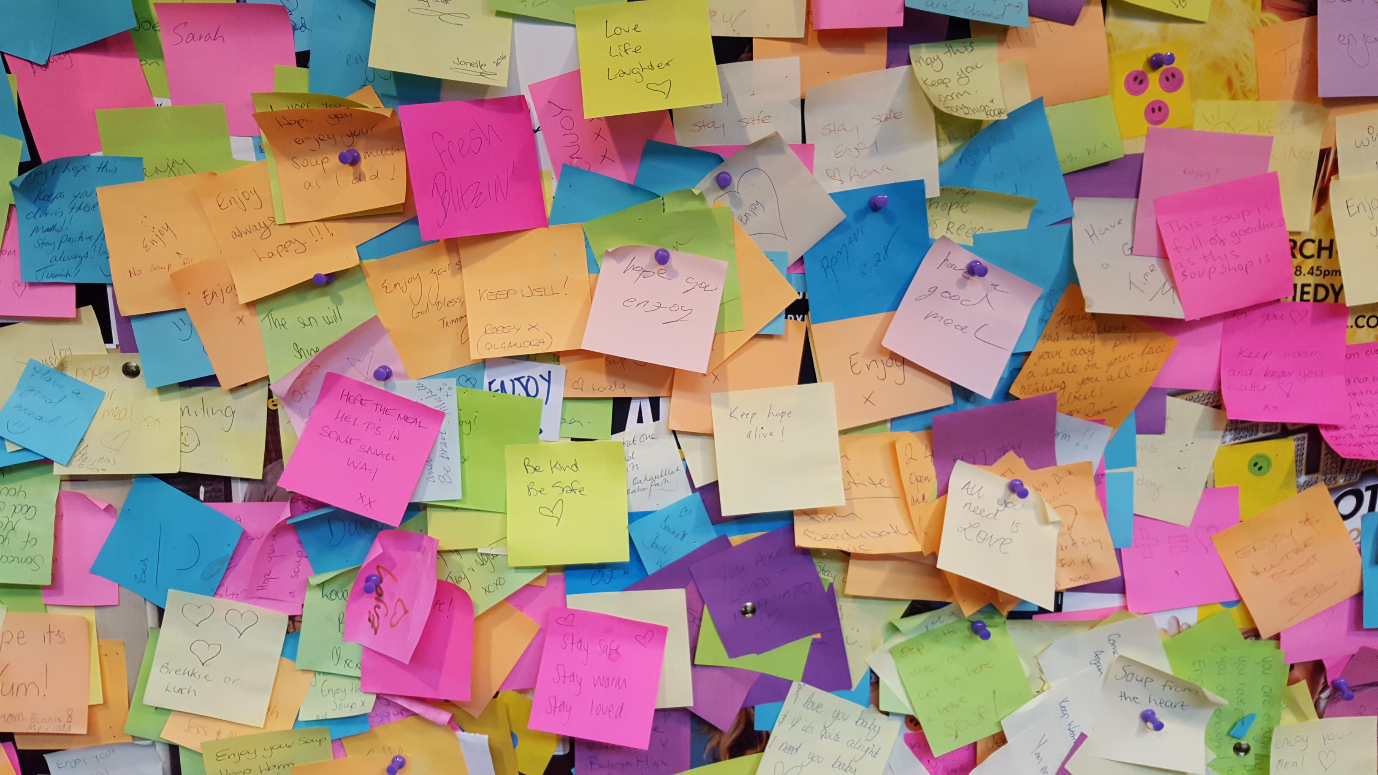
Tracking Technical Debt

Slide 109
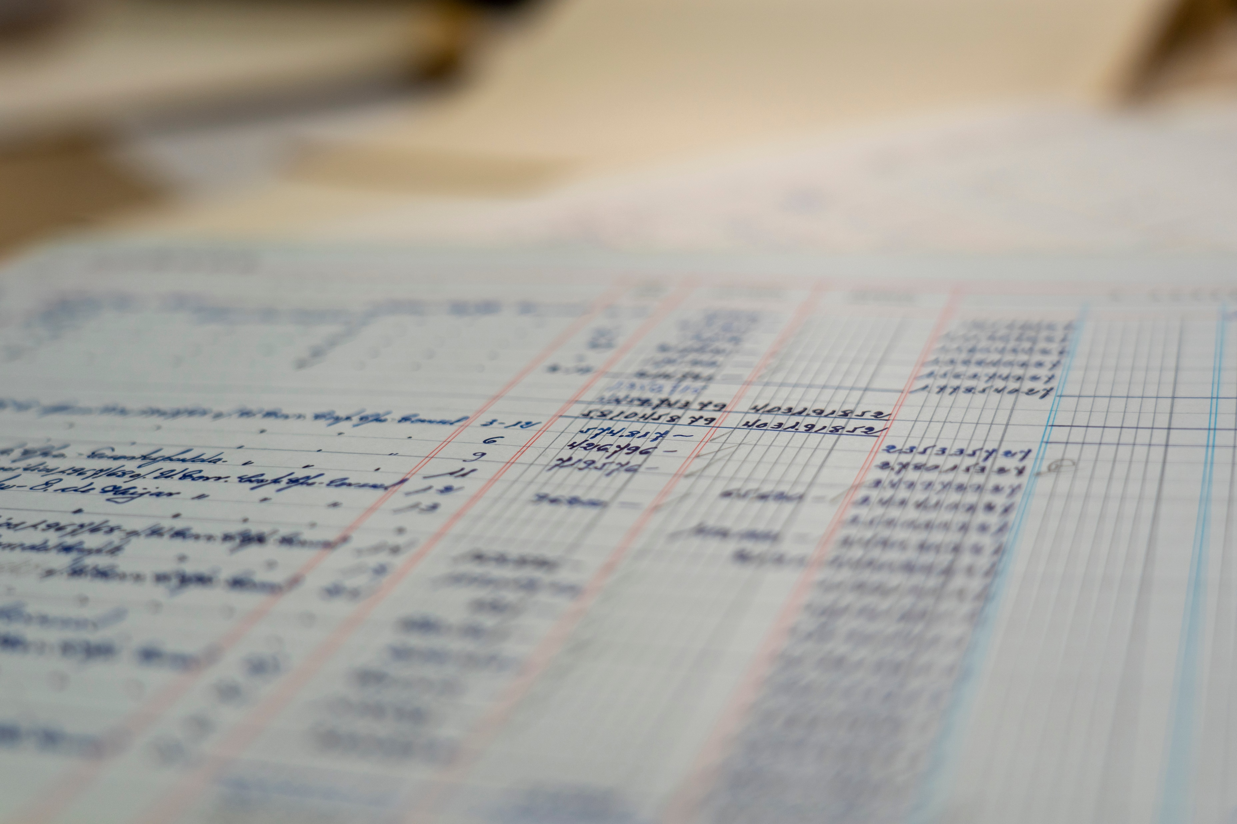
Technical Debt Register
Product
User Story #
Title
Criticality
Complexity
Reward
Remediation Cost
Technical Debt Score

Slide 110
Technical Debt Score
R : Reward
Cr : Criticality
Co: Complexity
(R x .2) + (CR x .15) - (CO x .15)

Slide 111
Technical Debt Score
(R x .2) + (CR x .15) - (CO x .15)
Id | Criticality (CR) | Complexity (CO | Reward (R) | Score | Rank
1451 | 5 | 1 | 5 | 1.6 | 1

Slide 112
Technical Debt Score
(R x .2) + (CR x .15) - (CO x .15)
Id | Criticality (CR) | Complexity (CO | Reward (R) | Score | Rank
1451 | 5 | 1 | 5 | 1.6 | 1
1452 | 1 | 5 | 1 | -0.4 | 3

Slide 113
Technical Debt Score
(R x .2) + (CR x .15) - (CO x .15)
Id | Criticality (CR) | Complexity (CO | Reward (R) | Score | Rank
1451 | 5 | 1 | 5 | 1.6 | 1
1452 | 1 | 5 | 1 | -0.4 | 3
1453 | 3 | 2 | 3 | 0.75 | 2

Slide 114
Technical Debt Score
(R x .2) + (CR x .15) - (CO x .15)
Id | Criticality (CR) | Complexity (CO | Reward (R) | Score | Rank
1451 | 5 | 1 | 5 | 1.6 | 1
1453 | 3 | 2 | 3 | 0.75 | 2
1452 | 1 | 5 | 1 | -0.4 | 3

Slide 115
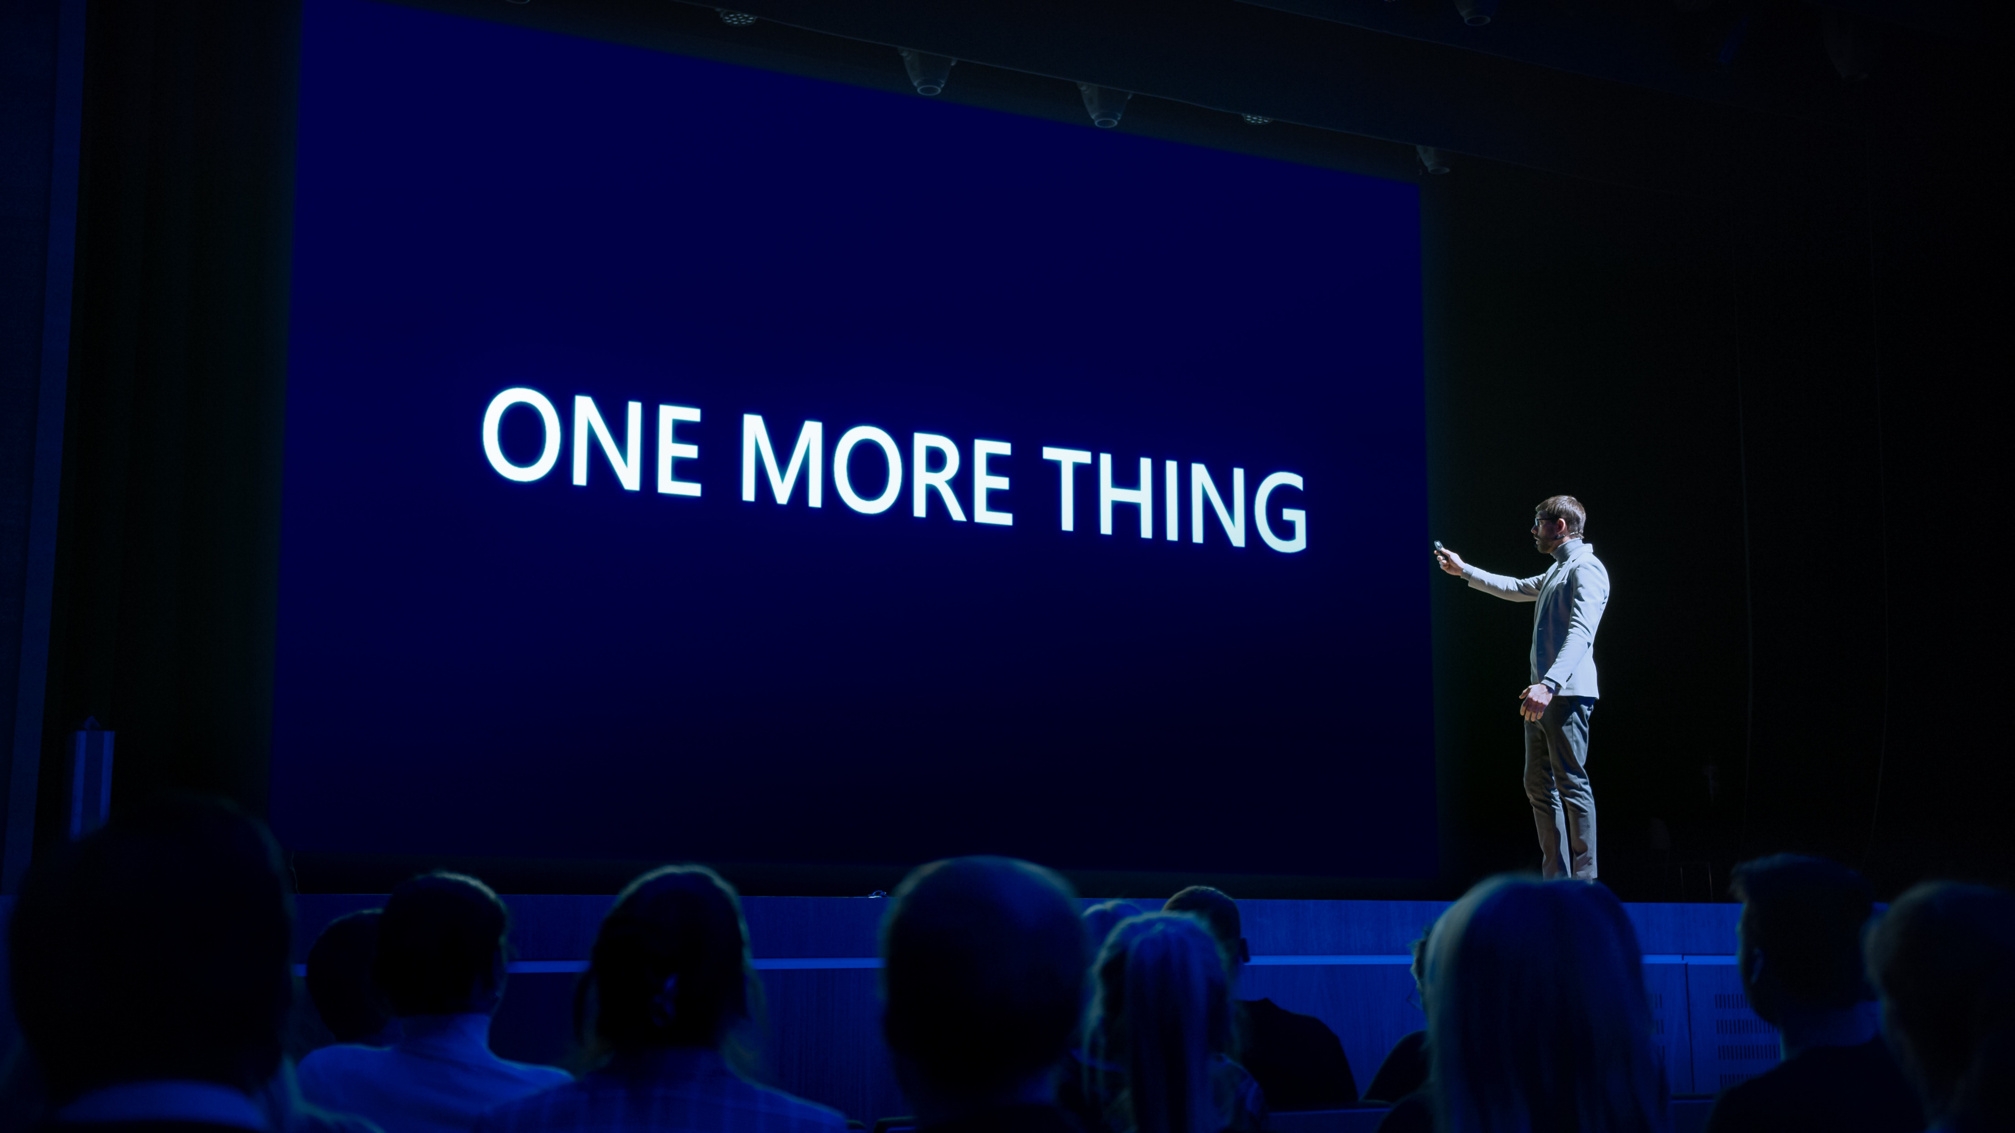
Notes:
AirPort, PowerBooks, MacBook Pro, iPod

Slide 116
Technical Debt Ratio
Technical Debt Is Not Free
Notes:
A simple ratio can show the technical debt as a relationship between the cost to fix the software system and the cost of developing it.

Slide 117
Technical Debt Ratio
(Remediation Cost / Development Cost) x 100%
Project | Remediation Cost | Development Cost | Technical Debt Ratio
Project 1 | 12.1 | 3,633.12 | 0.33%

Slide 118
Technical Debt Ratio
(Remediation Cost / Development Cost) x 100%
Project | Remediation Cost | Development Cost | Technical Debt Ratio
Project 1 | 12.1 | 3,633.12 | 0.33%
Project 2 | 702 | 18,728.55 | 3.75%

Slide 119
Technical Debt Ratio
(Remediation Cost / Development Cost) x 100%
Project | Remediation Cost | Development Cost | Technical Debt Ratio
Project 1 | 12.1 | 3,633.12 | 0.33%
Project 2 | 702 | 18,728.55 | 3.75%
Project 3 | 1,058.25 | 9,593.37 | 11.03%

Slide 120
Summary
Technical Debt Is Not Free

Slide 121
Technical Debt Is Not Free
What is technical debt?
Notes:
What is technical debt?
A state of unnecessary complexity, duplication, subpar code, or otherwise deficient code that introduces risks in the form of time, quality, security, team morale, or other forms. Typically, the results of past action or inaction.
Technical debt can be bad, it can be devastating; but it could also be useful and beneficial

Slide 122
Technical Debt Is Not Free
What is technical debt?
Pros and cons of technical debt
Notes:
Pros
Faster time to market
Short term competitive advantage
Short term capital preservation
Cons
Degradation of quality
Limits innovation
Longer development cycles
Reduces responsiveness to market changes
Higher upgrade costs
System compatibility issues
Poor end user experience
Develop

Slide 123
Technical Debt Is Not Free
What is technical debt?
Pros and cons of technical debt
Causes of technical debt
Notes:
Insufficient up-front definition
Business pressures
Tightly-coupled components
Parallel development
Lack of alignment to standards
Lack of knowledge
Poor technical leadership
Last minute specification changes

Slide 124
Technical Debt Is Not Free
What is technical debt?
Pros and cons of technical debt
Causes of technical debt
Types of technical debt
Notes:
Architecture
Build
Code
Defect
Design
Documentation
Infrastructure
People
Process
Requirement
Service
Test Automation
Test

Slide 125
Technical Debt Is Not Free
What is technical debt?
Pros and cons of technical debt
Causes of technical debt
Types of technical debt
Identifying technical debt
Notes:
Code Quality
Technical Deficiencies
Business Misalignment
Code Reviews
Pull Requests
Sprint Reviews
Stand Up
Coding
Code Analysis Tools

Slide 126
Technical Debt Is Not Free
What is technical debt?
Pros and cons of technical debt
Causes of technical debt
Types of technical debt
Identifying technical debt
Recoding technical debt
Notes:
Record in backlog
Probably not bugs
Add business context when communicating technical debt
Key Information to Record
Problem Statement
Story Points
Criticality
Complexity
Reward
Remediation Cost

Slide 127
Technical Debt Is Not Free
What is technical debt?
Pros and cons of technical debt
Causes of technical debt
Types of technical debt
Identifying technical debt
Recoding technical debt
Technical Debt Score
(R x .2) + (CR x .15) – (CO x .15)
Notes:
(Reward x .2) + (Criticality x .15) – (Complexity x .15)

Slide 128
Thank You!
chadgreen@chadgreen.com
TaleLearnCode
ChadGreen.com
ChadGreen & TaleLearnCode
ChadwickEGreen

